Slide 1
Aetna Sponsored Provider Trainings
Aetna Better Health of LA (ABHLA) has Over 20 events with 40+ hours of continuing education available in the ABHLA TPN.health library
Free Continuing Education for
Physicians*
Nurses*
Counselors
Addiction Counselors
Licensed Marriage and Family Therapist
Social Workers
Psychologists
Upcoming Topics:
Working with Special Populations
Co-occurring Developmental Disabilities & Mental Health Diagnosis
Fighting the Substance Abuse Epidemic
*Physicians and Nurses can earn continuing education on ABHLA sponsored events in the Provider Webinar Series for events that occurred after September 2022. Please check CE Details on each event before registering.
Notes:
Next event in this series is

Slide 2
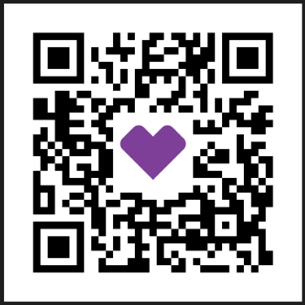
Aetna Sponsored Provider Trainings
Never miss an opportunity to earn FREE continuing education!
On Demand Education includes:
Evidence-based Practices, Promising Practices, Emerging Best Practices, Cultural Competency/Cultural Humility/DEE, Trauma-Informed Care, 3-Part Integrating Physical and Behavioral Health Series, Maternal Health, and many more
Join the Aetna Organization by visiting:
https://app.tpn.health/oi/bYMa
The Provider Webinar Series launches new events at least monthly
View your earned education hours with the CE Tracker
View your present and past CE Certificates
Explore TPN.health’ s full library of Continuing Education Opportunities
*Physicians and Nurses can earn continuing education on ABHLA sponsored events in the Provider Webinar Series for events that occurred after September 2022. Please check CE Details on each event before registering.

Slide 3
NEW! Health Equity Provider Training Series
The purpose of the Health Equity Provider Training Series is to increase knowledge, inform practice, and gain tools and techniques to advance health equity among staff and providers
The Health Equity Provider Training Series will provide staff and providers who directly engage in communities that experience health inequities the opportunity for training and education
This is an 11 Event Series which began July 17th and can now be accessed On Demand: Register Here

Slide 4
ADHD: Provider Resources
First-Line Treatment
Evidence- based behavioral therapies will be the first-line treatment for ADHD for children younger than six years of age, and other methods to increase the alignment with best practices for ADHD care for all children (CDC Guidelines).
Toolkit
Academy of Pediatrics Louisiana Chapter ADHD Toolkit is now available on the ABHLA Provider website and is located under the Behavioral health material and info section.
CPGs
The AAP publication of CPGs can be found here: Clinical Practice Guideline for the Diagnosis, Evaluation, and Treatment of Attention-Deficit/Hyperactivity Disorder in Children and Adolescents.
ADHD focused Free ABHLA Provider Education
ADHD Begins Early and Often Stays Late. How to Disinvite it Early in the Lifespan Party? (On Demand Registration Link)
Rethinking Adult ADHD: Helping Clients Turn Intentions Into Actions (On Demand Registration Link)
TEAM CBT: An Effective Focused Therapy (On Demand Registration Link)
Locate a Provider
To find a provider by Zip Code, Provider/Facility Name, or Specialty, Click Here.
To schedule a Telehealth/Telemedicine appointment with One Telemed, please call the referral line at 337-565-0669 or fax your referral to 337-210-2987.
CM Referral Form
You can now easily refer to Care Management by using the Provider CM referral form: ABHLA Care Management Provider Referral Form.
For additional help with your ABHLA members, please call member services at 1-855-242-0802, TTY 711.

